Slide 1


Welcome to our class
Teacher : Lê Thị Thạo
Week : 15
Period: 57
Grade: 3
Unit 4: Home - Lesson 3: A,B

Slide 2



LET’S SING AND DANCE

Slide 3


Week : 15
Period: 57
Grade: 3
Unit 4: Home - Lesson 3: A,B
G
O
R
O
O
O
D
A
T
E
N
F
N

Slide 4


Click each English word to hear the sound.
mirror
/ˈmɪrər/
cái gương

Slide 5

Click each English word to hear the sound.
picture
/ˈpɪktʃər/
bức tranh

Slide 6

Click each English word to hear the sound.
sofa
/ˈsəʊfə/
ghế sô-pha

Slide 7
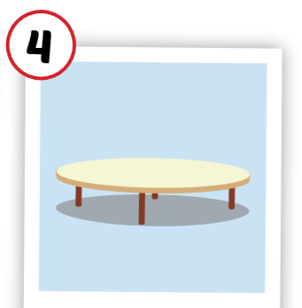
Click each English word to hear the sound.
table
/ˈteɪbl/
cái bàn

Slide 8

Click each English word to hear the sound.
box
/bɑːks/
cái hộp

Slide 9

Click each English word to hear the sound.
house
/haʊs/
ngôi nhà

Slide 10
LET’S PLAY GAME:

Slide 11




What’s missing.

Slide 12
What’s missing.

Slide 13
What’s missing.

Slide 14
What’s missing.

Slide 15
What’s missing.

Slide 16





Slide 17




Slide 18

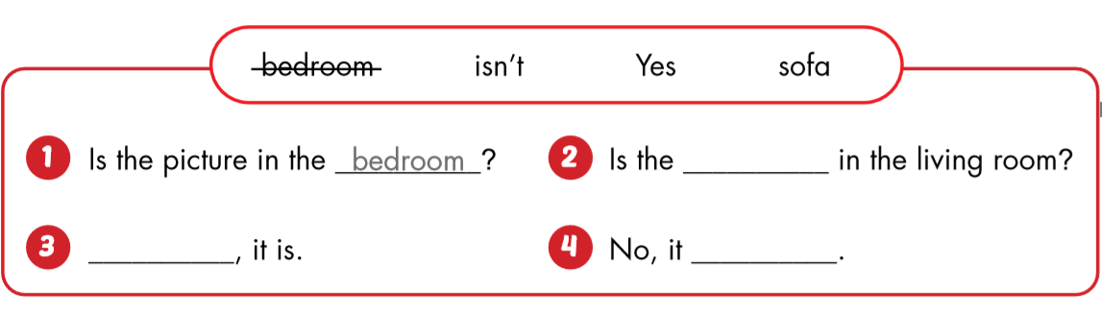
bedroom?
sofa
Yes
isn’t.

Slide 19
LET’S PLAY GAME:

Slide 20

*SUMMARY AND HOMEWORK
Review the vocabularies and sentence patterns.
Prepare the next lesson( Part C,D)

Slide 21

GOODBYE!
THANKS FOR YOUR ATTENTION!

Slide 22

Have a nice day!

